Slide 1
Unit 6: Time Series
Non-Stationary Models
Signal + Noise
ARIMA
ARUMA

Slide 2
Break Out 1

Slide 3
Break Out 1
For each person in your group:
Remind everyone of your realization
Defend why you thought a signal + noise, ARIMA, ARUMA, ARMA, or any other model was appropriate or not appropriate.

Slide 4
End Break Out 1

Slide 5
I feel like ARUMA is most appropriate.

Slide 6
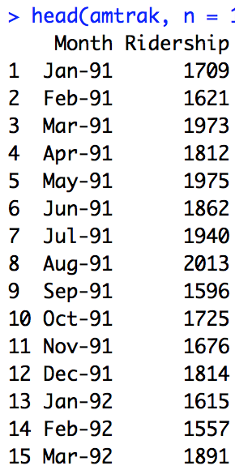
Monthly Amtrak Data

Slide 7


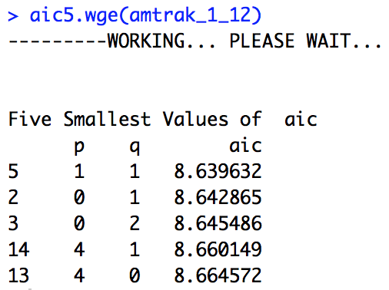
Monthly Amtrak Data
Given the several peaks in the spectral density and the intuitive presence of at least annual seasonality, the (1-B^12) factor was removed. At that point there was still significant wandering and some evidence of a (1-B) term in the acf therefore the (1-B) was taken out as well. At this point the realization looked stationary and the aic5.wge() favored the ARMA(1,1). For this reason, a reasonable model seemed to be the an ARUMA model with d = 1, s = 12, p = 1 and q = 1. This can be written as a ARIMA(1,1,1) with s = 12.

Slide 8
Break Out 2

Slide 9
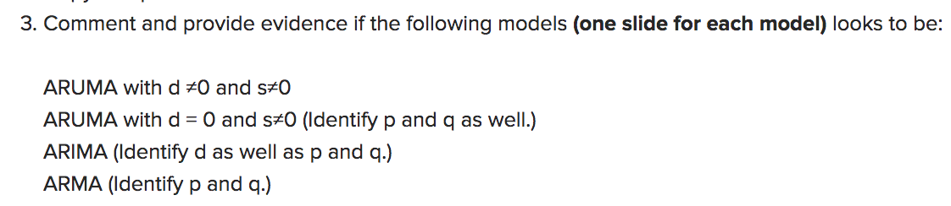
Break Out 2

Slide 10
(1−.8B)(1−B)X_{t} = a_{t}

Slide 11
(1−.8B)(1−B)X_{t} = a_{t}
ARIMA(1,1,0)

Slide 12
(1−.4B)(1−B)X_{t} = (1−.85B)a_{t}

Slide 13
(1−.4B)(1−B)X_{t} = (1−.85B)a_{t}
ARIMA(1,1,1)

Slide 14
(1−.4B)(1−B)(1−B⁴)X_{t} = (1−.85B)a_{t}

Slide 15
(1−.4B)(1−B)(1−B⁴)X_{t} = (1−.85B)a_{t}
ARIMA(1,1,1) with s = 4

Slide 16
(1−.4B-.74B³)((1−.6B)(1−B)²(1−B¹²)X_{t} = (1−.85B²)a_{t}

Slide 17
(1−.4B-.74B³)((1−.6B)(1−B)²(1−B¹²)X_{t} = (1−.85B²)a_{t}
ARIMA(4,2,2) with s = 12

Slide 18
Simply Judge From These Plots

Slide 19
Simply Judge From These Plots
ata = gen.aruma.wge(500,d = 1, s = 12, phi = -.7, theta = -.9, sn = 9)

Slide 20
Simply Judge From These Plots

Slide 21
Simply Judge From These Plots
data = gen.aruma.wge(500,d = 2, phi = -.7, theta = -.9, sn = 9)

Slide 22
End Break Out 2

Slide 23
Break Out 3

Slide 24
Stock Modeling
For each member of your group
Describe the stock you picked
Describe the analysis you performed to try and identify a model.

Slide 25
End Break Out 3

Slide 26


https://www.wsj.com/articles/sohn-stock-tips-may-not-be-worth-peanuts-1524592131

Slide 27
MO
getSymbols("MO", from = "2018-6-10", to = "2019-6-10", auto.assign = TRUE)
plotts.sample.wge(MO$MO.Close)
MO1 = artrans.wge(MO$MO.Close,1)

Slide 28
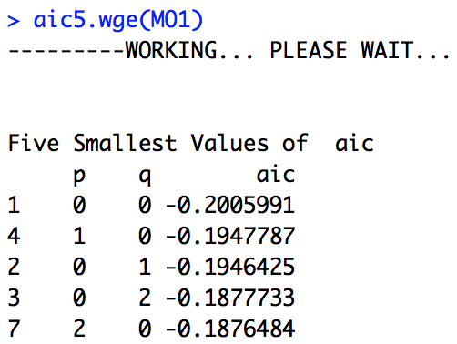
MO
MO1 = artrans.wge(MO$MO.Close,1)

Slide 29
Break Out 4

Slide 30
Break Out 4
Identify the seasonality if any:
(1−.76B - .94B⁴ +.75B⁵)X_{t} = a_{t}

Slide 31
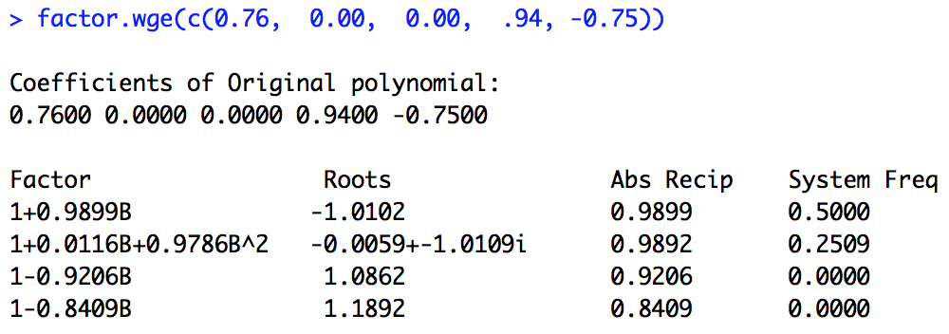
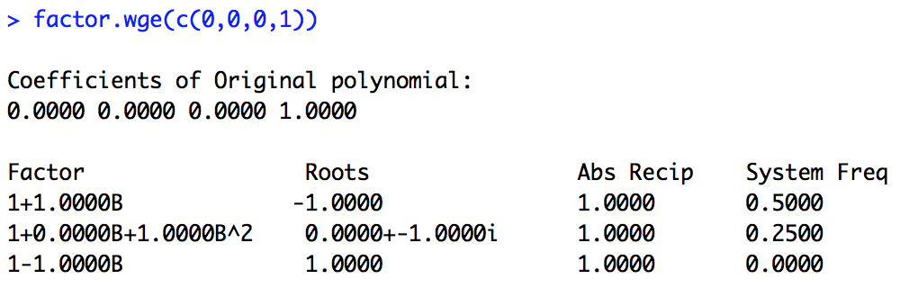
Break Out 4
Identify the seasonality if any:
(1−.76B - .94B⁴ +.75B⁵)X_{t} = a_{t}
factor.wge(c(0.76, 0.00, 0.00, .94, -0.75))

Slide 32
Break Out 4
Identify the seasonality if any:
(1−.76B - .94B⁴ +.75B⁵)X_{t} = a_{t}

Slide 33
Break Out 4
Identify the seasonality if any:
(1−.76B - .94B⁴ +.75B⁵)X_{t} = a_{t}
factor.wge(c(0.76, 0.00, 0.00, .94, -0.75))

Slide 34
Which Model has Annual Seasonality
Model 1
(-0.1B - 0.72B² + 0.016B³ + 0.29B⁴ - 0.02B⁵ - 0.144B⁶ + 0.0032B⁷ - 0.0621B⁸ + 0.008B⁹ + 0.058B¹⁰ - 0.00128B¹¹ - 0.0072B¹²)Xt = at
factor.wge(c(0.1, 0.72, -0.016, -0.29, 0.02, 0.144, -0.0032, 0.0621, -0.008, -0.058, 0.00128, 0.0072))
Model 2
factor.wge(c(-0.2000, 0.6300, 0.0000, 0.0000, 0.0000, 0.0000, 0.0000, 0.0000, 0.0000, 0.0000, 0.0000, 0.9700, 0.1940, -0.6111))

Slide 35
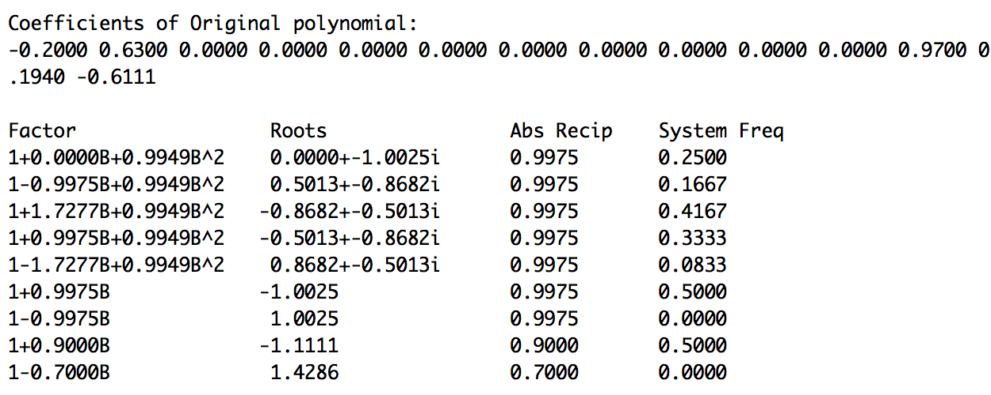
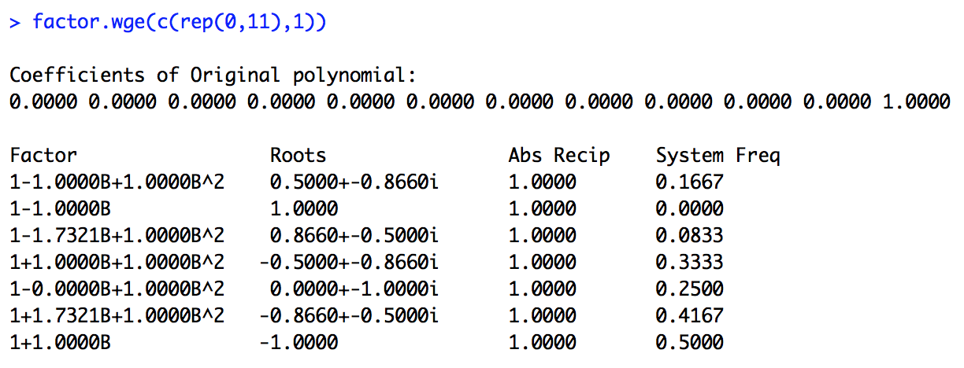
Which Model has Annual Seasonality
Model 2
factor.wge(c(-0.2000, 0.6300, 0.0000, 0.0000, 0.0000, 0.0000, 0.0000, 0.0000, 0.0000, 0.0000, 0.0000, 0.9700, 0.1940, -0.6111))

Slide 36
End Break Out 4

Slide 37
Nyquist Frequency Discussion
#Nyquist Frequency
## Data Generation
We have generated data that has a frequency on the scale of seconds of .02. That is, the data have a period of 50 seconds.
We have then sampled only at every minute (every 60th observation). Note that this has a frequency around .2.
```{r}
library(tswge)
P02 = gen.sigplusnoise.wge(6000,coef = c(1,0), freq = c(.02,0), vara = 0)
parzen.wge(P02)
x = seq(1,6000, by = 60)
Min = P02[x]
parzen.wge(Min)
par(mfrow=c(1,2))
parzen.wge(P02)
parzen.wge(Min)
```
## Scenario
Consider now that the data we observed first was the data observed at every minute. We would then see a frequency of about .2.
```{r}
parzen.wge(Min)
```
However, there was another frequency present but we could not observe it ... unless we sample faster.
The P02 data is the data that was then recorded at the seconds. Each 60th data point is the same as the Minute data ... but there is a much different frequency present now. Now each integer represents a second.
```{r}
parzen.wge(P02)
```

